Slide 1
Wk1_M: Outline
CSCI3170 24T1
Introduction to Database Systems

Slide 2
Presumed Background
The course design assumes you have basic knowledge about data structures, such as graphs, trees, and hash indexes.
You need to complete a group project using Java in a Linux environment.
Prerequisite: CSCI2100 or 2520 or ESTR2102.
For 2nd-year entrants, the prerequisite will be waived.

Slide 3
References
Database Management Systems Raghu Ramakrishnan, Johannes Gehrke, Mcgraw Hill, 3rd Edition (textbook)
Database System Concepts Abraham Silberschatz, Henry F. Korth, S. Sudarshan., McGraw-Hill, 6th Edition
Concurrency Control and Recovery in Database Systems P.A. Bernstein and V. Hadzilacos and N. Goodman, Addison Wesley, Reading, Massachusetts

Slide 4
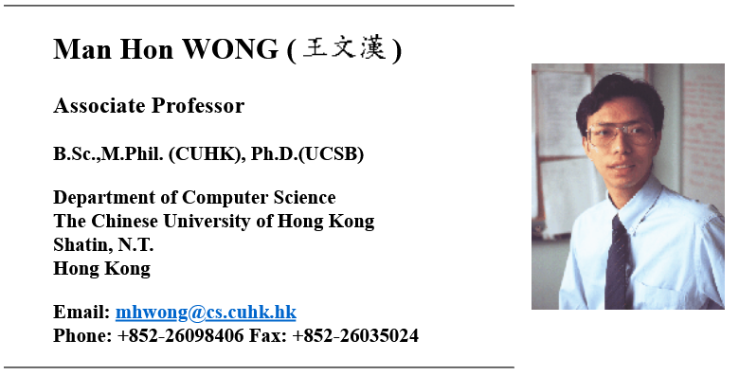
Reference (2)
Course syllabus and slides largely using or follow from those polished by Prof. WONG Man Hon.

Slide 5
Personnel (1)
24T1 Instructor
Dr. YU, Michael Ruisi (mryu@cse.cuhk.edu.hk)
Consultation Hours: SHB 127, Mon 15:30 – 17:30
Small note: for consultation, reservation strongly recommended at least the day before please, thank you.

Slide 6
Personnel (2)
Teaching Assistants
TAs will be responsible for the majority of grading of students in their dedicated sections.
Emails directed to individual Tas, can be CCed to me.
Name | Email
DING Wenlong | wlding21@cse.cuhk.edu.hk
GAO Jialin | jlgao@cse.cuhk.edu.hk
LIU Yuqi | yqliu24@cse.cuhk.edu.hk
LU Haodong | hdlu24@cse.cuhk.edu.hk
ZHANG Yiyi | yyzhang24@cse.cuhk.edu.hk

Slide 7
Email Contact Policy
If you don’t want to ask in class, send us an email.
This would be obvious… you must be mindful to:
include name
include student ID
include the Course Code? (i.e. CSCI3170)
Any requests for very last minute assistance on assessments will not likely be responded to timely
2024-2025 T1 (Michael Yu's Slides)

Slide 8
Course Resources
Lecture notes, assignments & announcements are all made available through Blackboard
Assume No Lecture Recordings
For help outside of class
Blackboard forum usage very encouraged for course related discussions
Tutors will visit the forum regularly to answer questions
“Pop-up” course consultation session (TAs and myself) subject to majority request and availability of teaching team
Consultations with me (?)
2024-2025 T1 (Michael Yu's Slides)

Slide 9
Venue and Time
Room | Time | Venue
LEC/d1/01 | M 10:30am – 11:15am | MMW_LT1
LEC/d2/01 | W 2:30PM - 4:15PM | MMW_LT1
TUT/01 | M 11:30am-12:15pm | MMW_LT1
TUT/02 | T 2:30pm – 3:15pm | SC_L5
TUT/03 | W 4:30pm – 5:15pm | MMW_LT1
Note blackboard announcements for any changes
I anticipate week 7 Wed lecture to be affected, more news later

Slide 10
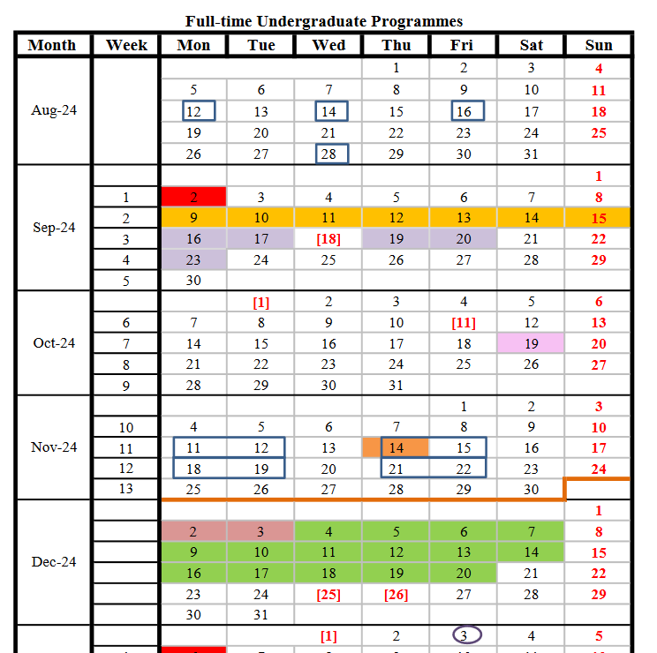
Known Public Holidays
Impacts
LEC/d2/01 (x1)
TUT/03 (x1)
TUT/02 (x1)

Slide 11
Main Assessments
There is 1 project assignment
Three students will form a group to complete the project.
TAs will set up the project accounts for all students and give tutorials on using the Database system.
There will be 2 - 3 assignments

Slide 12
Short Classwork
There will be 5 - 8 short classwork.
Classwork are usually simple and short.
A pass-fail grading system is used.
Perfect answers not expected
You will pass if you have tried to write down some answers relevant to the questions
Classwork questions:
Sample answers also provided
To be released on course website at every interval

Slide 13
Exams and Grading Policy
Short Classwork (5-8) | 12%
Homework (2-3): | 18%
Project (1): | 20%
Final Exam (1): | 50%
Passing requirements:
The total mark above passing line (usually 45% - 50%),
The score in final exam above 35%, and
The score in project above 35%.

Slide 14
Expectations
In accordance with the University’s “Policy on External Referencing to Hong Kong Qualifications Framework” approved by the Senate
1-unit course would include one classroom contact hour and 2-2.75 student self-study hours
Times that by 3 for a 3-unit course, plus two to three hours of assessment.
https://www.cuhk.edu.hk/clear/qm/A5-1.pdf

Slide 15

Academic Honesty
NO PLAGIARISM 嚴禁抄功課
No copying from others
No “lending” your work to others
Interesting toolkit on software similarity
http://theory.stanford.edu/~aiken/moss/ (for your eyes only)
Every plagiarizing case will be reported to the Faculty. http://www.cuhk.edu.hk/policy/academichonesty (CUHK) https://www.erg.cuhk.edu.hk/erg/AcademicHonesty (ERG)
2024-2025 T1 (Michael Yu's Slides)

Slide 16
Academic Honesty
In relation to the group project
“All members of the group should be asked to sign the declaration, each of whom is responsible and liable to disciplinary actions, irrespective of whether he/she has signed the declaration and whether he/she has contributed, directly or indirectly, to the problematic contents.”

Slide 17
Academic Honesty
What is plagiarism? An over-simplified guide
Did you copy someone's work?
Did you copy a part of someone's work?
Did you not do the work yourself?
Did you release your work to a third party?
I gave my work to someone?
[NEW] I used AI on my assessment?

Slide 18
CUHK AI Policies
All use of AI tools is prohibited in assignments and assessment tasks (Applies to us)
Use of some AI tools is allowed or
Use of AI tools is allowed with explicit acknowledgement and proper citation
Use of some AI tools is allowed with no acknowledgement
You may refer to the CUHK Library website on AI in Education
https://libguides.lib.cuhk.edu.hk/c.php?g=917899&p=6975970

Slide 19
Approach 1 Details (CSCI3170)
For assignments and assessment tasks that count towards the final course grades:
“students are not allowed to submit work which is produced with the collaboration of or supported by the use of any generative AI tools (e.g. ChatGPT)*.”
“Any breach of the regulations will be considered an act of academic dishonesty and will be handled according to the University’s Procedures for Handling Cases of Academic Dishonesty.”
In case of queries, students should seek advice from the course teacher.

Slide 20
Special Considerations
If you ever want special considerations, tell me
On deadline extension
You MUST inform me at least 24 hours BEFORE the specified deadline
On sick leave
You MUST inform me BEFORE class begins
You MUST provide a medical certificate within 7 days

Slide 21
Special Considerations
DO NOT go to the exam If you are not well enough to do so. I will consider your attendance proof that you were OK at the time of the exam. Go to the Doctor and apply for special consideration.

Slide 22
Learning Summary/Approach
You’ll mostly be fine in our exam if you…
Follow lecture materials
Attempt all the practice exercise questions with solutions
Understand the theoretical component
Make the most of the prac. component in the tutorials

Slide 23
Class Etiquette
For everyone’s convenience, remain reasonably quiet in class for your peers. Thx in advance
I will also sometimes release a survey at the end of the class to facilitate peer learning. This is for my reference only.
I’ll aim to end on time by the :15
I’ll wait 5 minutes prior to start of lecture
You’ll get at least 10 minutes of break in-between classes

Slide 24
Checkpoint A
Questions?
One Question from the course:
Is there anyone here not enrolled into the course and are facing difficulties?

Slide 25
Pathways from CSCI3170
In CSCI3170, we introduce the foundations & technology of databases
skills: how to build database-backed applications
theory: how you know for sure that what you built was good
“This course introduces the concepts and principles of database management systems. Subjects include: basic concepts, system structures, data models, database languages (SQL in particular), relational database normalization, file systems, indexing, query processing, concurrency control and recovery schemes.”

Slide 26
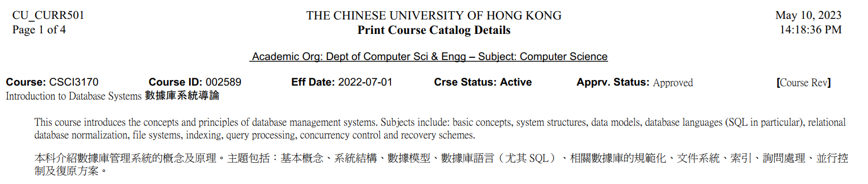
Did you find that familiar?
It’s from the up-to-date course outline

Slide 27
Objective and topics outline (1)
The first half of the course covers issues related to the design and implementation of relational database applications.
Topics include:
Data modeling
Database languages
Relational database design principles
Schema Refinement
Decompositions

Slide 28
Objective and topics outline (2)
The second half of the course covers issues related to the internal organization of a DBMS.
Topics include:
File system organization
Indexing methods
Query optimization
Transaction processing

Slide 29
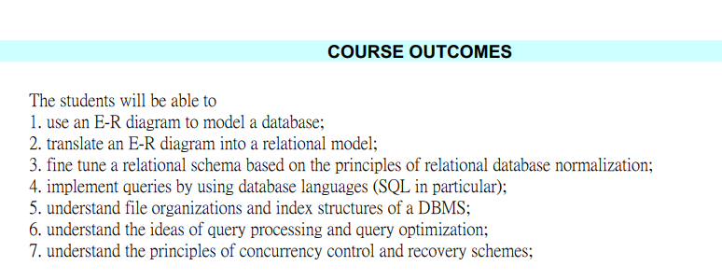
From Course Catalog (2)

Slide 30
Pathways from CSCI3170 (2)
After CSCI3170, you can go on to study ...
how to build relational DBMSs
(write your own PostgreSQL or Oracle)
techniques for data mining
(discovering patterns in DB)
web data compression and search
(dealing with a large amount of Web data)
information retrieval, web search (dealing with text data)
service-oriented computing, which relies on DB background

Slide 31
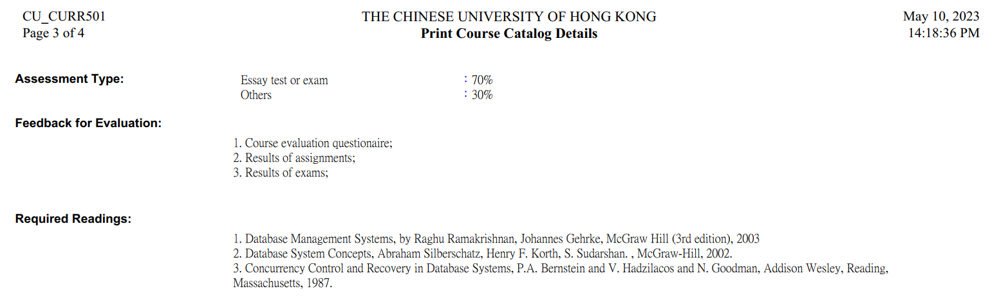
From Course Catalog (3)
Feedback for Evaluation
Required Readings

Slide 32
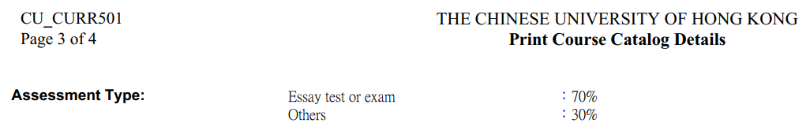
From Course Catalog (4)
Some minor inconsistencies in this part, we refer to the slides above for the assessment type and grading criteria.

Slide 33
Checkpoint B
15 min break

